Slide 1



LOCK & KEYS
TO
Hac-KEY-ing
HPE MENTORS
Mrs. Supriya Kamthania
Ms. Manisha M
VIT MENTORS
Dr. Manikandan N.
Dr. Priya V

Slide 2
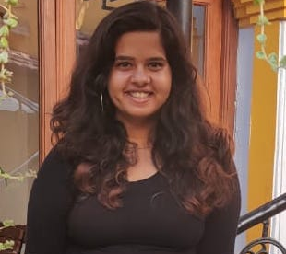
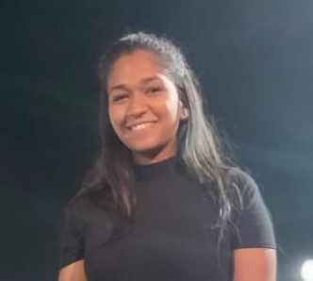






Meet Our Team
Urmila
Spriha
Soham
Bharat
Script Kiddie
White Hat Hacker
Red Hat Hacker
Grey Hat Hacker

Slide 3
AGENDA
Your Text
SQL INJECTION
The Threat
Tools Explored
SQLMAP
Its Automation
FUTURE PROSPECTS
SUMMARY
Your Text
Your Text
Your Text
Example Text :
Get a modern PowerPoint Presentation that is beautifully designed.
INSECURE DESERIALIZATION
SECURITY THREAT
LANDSCAPE
Application
The Threat
Tools Explored
Its Automation

Slide 4
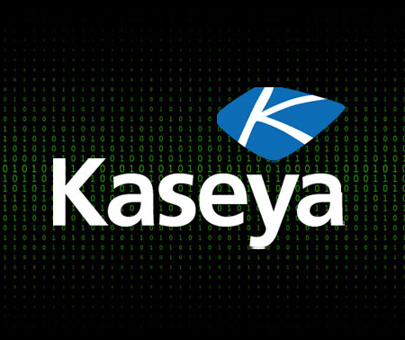
THE MASTERY OF ATTACKS
Internet
Servers
Hackers & Snoopers
Governments

Slide 5
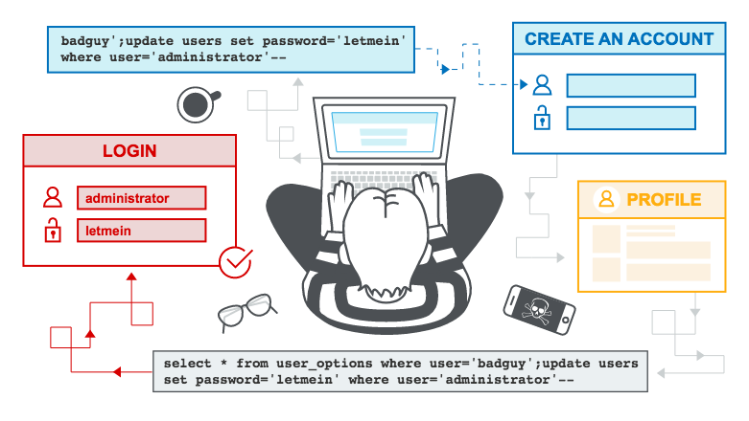
SQL INJECTION
Malicious SQL commands && a vulnerable URL
THE REAL THREAT
Leakage of sensitive information
Reputation decline
Data Loss leading to loss of control of db server

Slide 6
KEY PROCESS INVOLVED
SECURE
SCAN
SECURITY
EXPLORE
EXPLOIT

Slide 7
COMPARE-O-METER
ROBUSTNESS
LEVEL OF ATTACK
EASY TO USE
FUTURE RESEARCH PROSPECTS
SQLMAP
JSQL
VEGA
ZAP
BBQSQL
NOSQLI
NOSQLMAP

Slide 8
THE SQLMAP+ INNOVATION
Faster
Faster processing of voluminous SQL commands
Reduced processing timelines
Competent
Reduce the need of outsourcing
Increase competency
Efficient
Achieve more results with lesser effort.
Accurate
Reduction in enterprise costs
Reduction in time involved in executing research activities
Improved workflow efficiencies.
Easy Integration
Easy integration with other features
Reduced manual effort

Slide 9
INTRODUCTION
Your Password?
I have it!
I may have stolen it
SERIALIZATION
DESERIALIZATION
INSECURE
DESERIALIZATION
!
YOU DON’T TAKE ME SERIOUSLY, I’LL SHOW HOW SERIOUS I CAN BE!
The Struts 2 Incident! What happened?

Slide 10

My Application Code is not mine anymore!
Python
Java
A PICKLE VULNERABILITY?
WHAT IS THE PROBLEM WITH THE NAME OF MY CLASS?
PHP
WHAT DOES SERIALIZING AND UNSERIALIZING MEAN?

Slide 11
The Tools Explored
Internet
OBJECTMAP TOOL
PHP OBJECT INJECTION TOOL
JAVA DESERIALIZATION SCANNER

Slide 12

PROTECTION
Isolating and running codes in low privilege environment
Implementing integrity checks
Enforcing strict type constraints
Logging deserialization exceptions and failures
Restriction on network connectivity
Monitoring deserialization

Slide 13
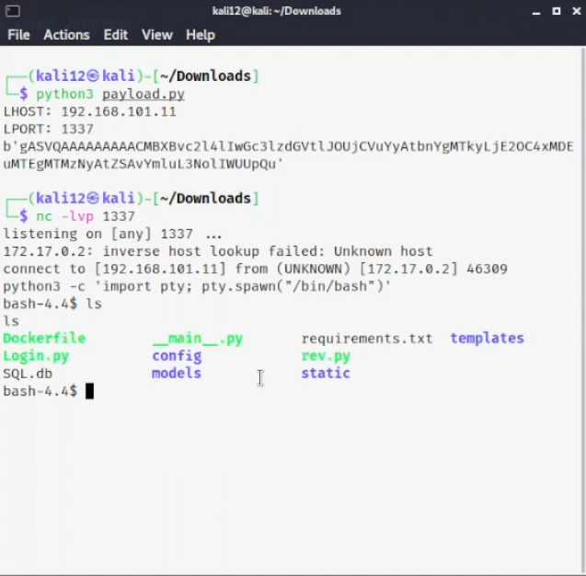
Impact and Exploitation
provides an entry point
reuse existing application code in harmful ways
lead to privilege escalation
arbitrary file access, and denial-of-service attacks.
CIA Triad
“It takes 20 years to build a reputation and a few minutes of cyber incident to ruin it.”

Slide 14
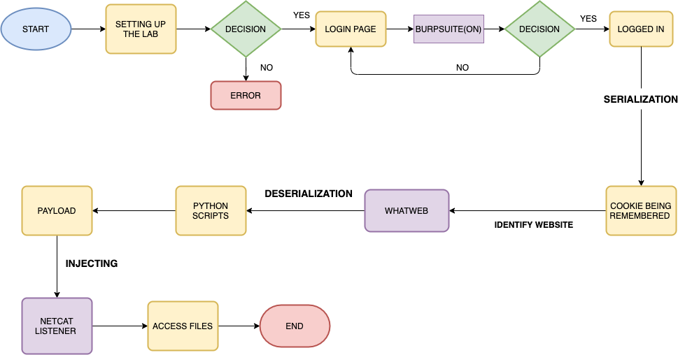
Insecure Deserialization

Slide 15
FUTURE PROSPECT
WEB APPLICATION
INTENSIVE FEATURES
INTENSIFIED LEVEL OF ATTACK
EXPLORING NOSQLMAP, NOSQLI AND OTHER NOSQL DATABASE
MERGE SQLI WITH OTHER ATTACKS

Slide 16
Summary
APPLICATION SECURITY
INNOVATION
Aim to prevent data breaches within applications
Tools made Easier to use
Efficiency Increased
01
02
OWASP TOP 10 EXPLORED
NEXT STEP
SQL Injection
SQL injection is the placement of malicious code in SQL statements, via web page input.
Insecure Deserialization
Known as Object Deserialization. Manipulates serialized objects in the code.
Add Text
Web Application
Intensive Features
Intensified Level Of Attack
Exploring Nosqlmap, Nosqli And Other Nosql Database
Merge Sqli With Other Attacks
04
03

Slide 17
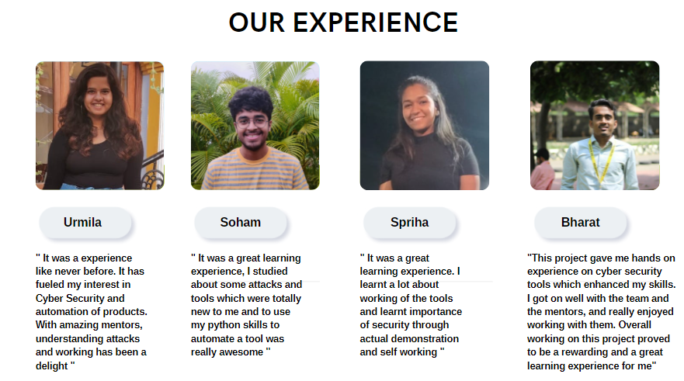

Slide 18
THANK YOU

